Slide 1

SQL Shopping Manager!
By Dhruv Rawal and Adit Sinha Step By Step School

Slide 2
Contents
S. No. | Topics
1. | Problem
2. | Our solution
3. | Key Product Features
4. | Mode of Operation & Funding
5. | Traction and Projections

Slide 3
Problem:
Shopping for clothes can be a tedious process for both users and vendors, especially when it comes to maintaining a uniform system. Oftentimes, the simple act of purchasing a cloth requires a plethora of data structures to be used. To simplify the need of these structures, and to enhance the user’s experience, we propose this product.

Slide 4
Our solution:
Organizing all the clothes a store has in stock into a single uniform SQL table, and allowing the user to view these clothes and save them into their cart to purchase at any time instantly enhances the experience on both ends. Moreover, it makes it easier for a vendor to maintain information of clothing articles since the Data table clearly differentiates each article.

Slide 5
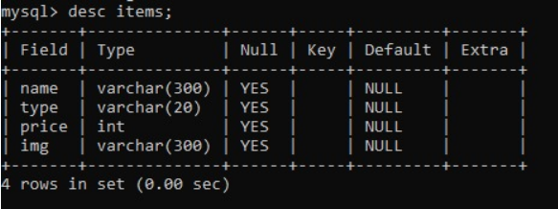
Key Product Features
Through several simple additions, this product solves the rising crisis of data management: 1. Uniform Data Table: Through a single data table (structure of which is shown below), the python program is informed of parameters for the Name, Type, Price, etc. of the clothing article in one place; therefore creating a uniform platform for data management.

Slide 6
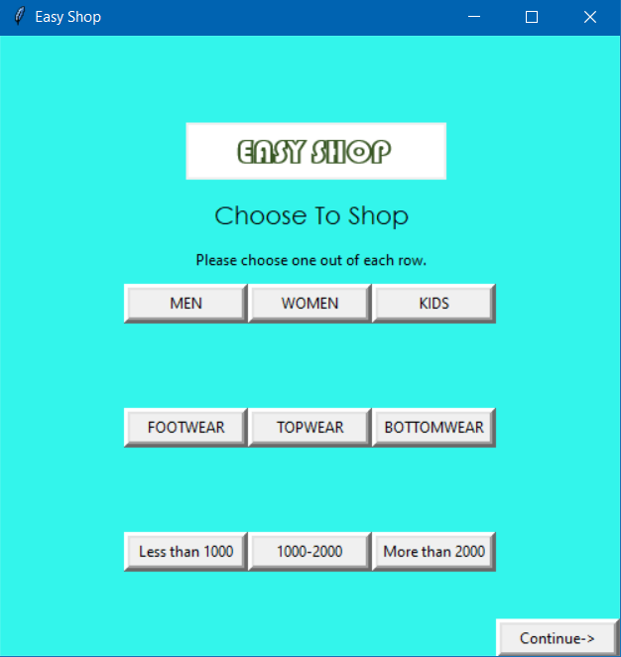
2. Simple Quick Choices Since the user is provided multiple simple choices to filter their products, their experience also gets enhanced by eliminating irrelevant data. This can further be expanded in other parameters in the future. An interactive home-page also further enhances their experience.

Slide 7
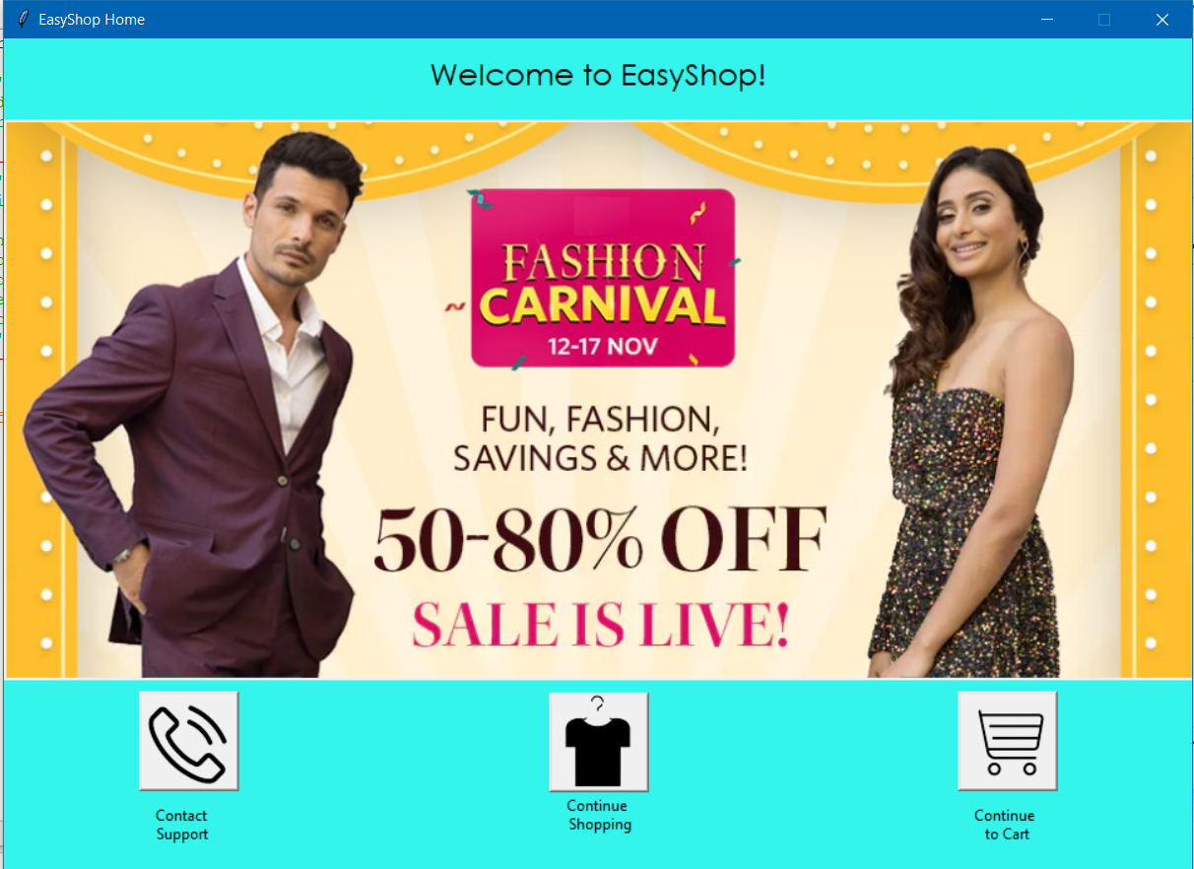

Slide 8
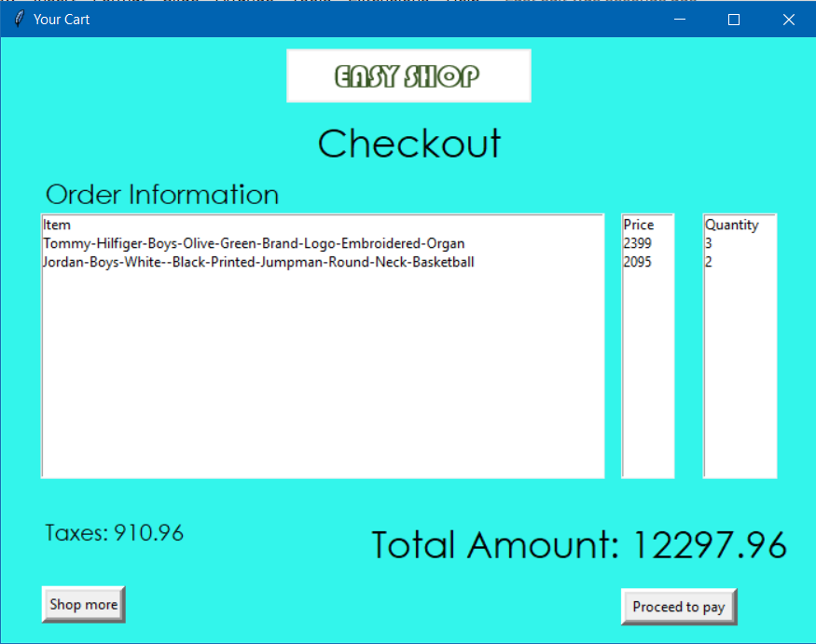
3. Quick and Simple Checkout Procedure: Due to the presence of the Cart SQL table, the vendor can easily calculate the billing information via the SUM() function, while also maintaining the user’s shopping record. Moreover, the user can also access their saved previous session before billing, further enhancing their experience.

Slide 9

Mode of operations & funding
Due to the simplicity and dynamic nature of our program, the only running costs would be in maintaining the server. The funds for this would, of course, have to be provided by any establishment that would like to use our software. Most data management servers run for a simple price of 30-50 dollars per month. Since the algorithm for the program remains uniform, the software can be charged to be run for 70-80 dollars, increasing the funds by 150%.

Slide 10
Traction and Projections
Our product is mainly meant to be used in apparel stores, but can easily be adapted to fit any kind of shop, such as a hardware stores, furniture shops, etc. whether online or offline.
Our vision for this product is to help create a system that makes the experience of shopping more streamlined for the customer, as they can search for and view all the clothes they want across genders and age groups at one terminal

Slide 11
THANK YOU!

